Slide 1
Decision Tree and Random Forest Data Science Assignment 3
February 11, 2022
Daksh Patel

Slide 2
Decision Trees
A decision tree is a decision-making aid that employs a tree-like model of decisions and their potential results, such as chance event outcomes, resource costs, and utility. It's one approach to show an algorithm made up entirely of conditional control statements.
Libraries
pandas
numpy
matplotlib
seaborn
sklearn

Slide 3
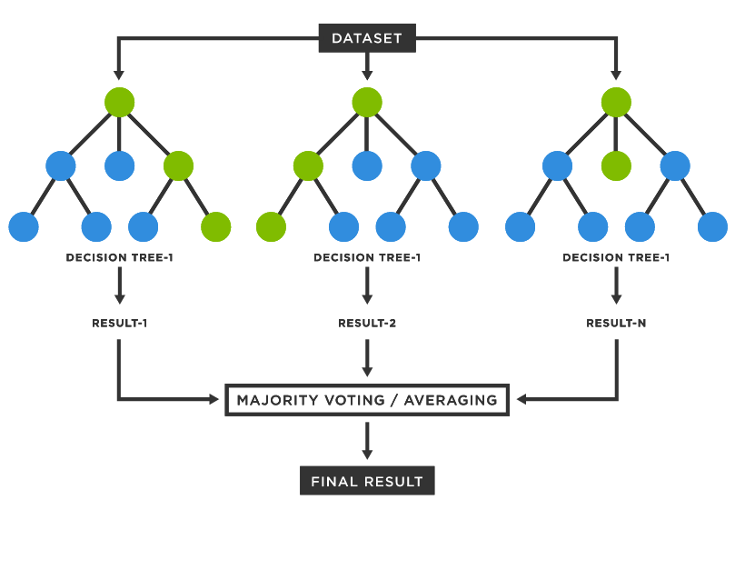
Random Forest
Random forest is an ensemble learning method for classification, regression and other tasks that operates by constructing a multitude of decision trees at training time.
Libraries
pandas
numpy
matplotlib
seaborn
sklearn

Slide 4
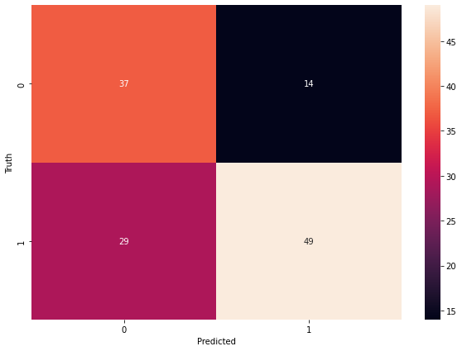
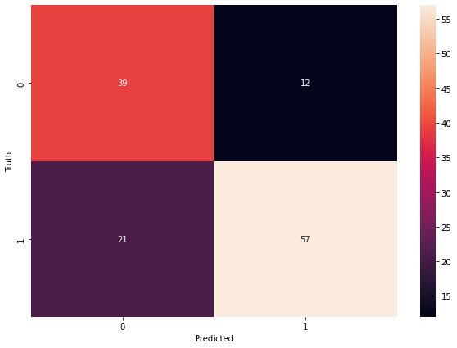
Output
Decision Tree
Random Forest

Slide 5
Conclusion
Random Forest usually outperforms decision tree as it uses multiple decision trees to prediction.
Increase in number of trees in random forest , leads to increase the processing time with higher accuracy.

Slide 6
Thank You

